Slide 1
Lab 5: An Application of Probability Distributions
STAT 201: Elementary Statistics
As you enter room:
* Find your name on the sign in sheet.
Sign In by your Name
Find the Table you were randomly assigned.
** Sit at any of the seats and the table you were assigned.
Graded Lab Reports will be returned – keep these in case of an issue with the gradebook

Slide 2

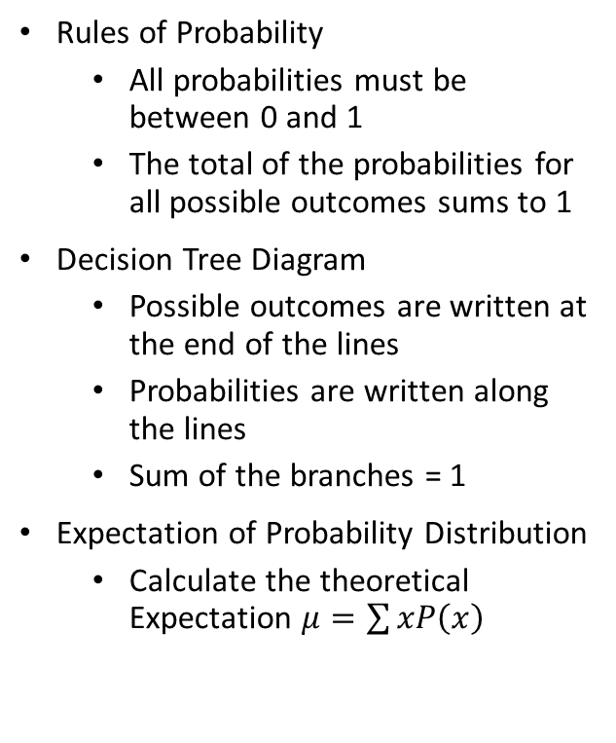
Concepts needed for this lab
Rules of Probability
All probabilities must be between 0 and 1
The total of the probabilities for all possible outcomes sums to 1
Decision Tree Diagram
Possible outcomes are written at the end of the lines
Probabilities are written along the lines
Sum of the branches = 1
Expectation of Probability Distribution
Calculate the theoretical Expectation $μ=\sum{xP\left(x\right)}$

Slide 3
Setting
Insurance companies use probability models to quantify uncertainty and predict outcomes in the long run. These probability models guide the company in developing insurances plans with a high likelihood of profit in the long run.
This lab –
Passengers of a luxury Mediterranean cruise that costs $3000 have the option to purchase travel insurance.
This insurance will cost them $350.
With the insurance if the passenger needs to cancel their cruise for either of the following two reasons they will get their $3000 back:
Reason 1 – personal – illness, work, family emergency, etc.
Reason 2 – flight cancellation/delay and they miss the cruise.

Slide 4
From the Customer’s Perspective
The customer decides to purchase the $350 insurance.
They have had bad experiences before with flights and you are concerned something personally might come up and they will miss the cruise.
Even though it seems costly they are going to pay the $350 in order to make sure they get their $3000 back in case they miss the flight (i.e. they are only out $350).
If they didn’t get the insurance and they weren’t able to go on the trip they would be out $3000.

Slide 5
From the Insurance Company’s Perspective:
The company estimates the following:
5% of customers with the insurance will not be able to travel for personal reason.
4% of those that are able to personal travel will not make the cruise due to missing their flight.
If the customer that has paid for the insurance and is able to go on the cruise the company gains $350.
If the customer that has paid for the insurance and is not able to go on the cruise the company loses $2650 ($3000 - $350).
THE PURPOSE OF THIS LAB – the insurance company is reviewing the current cost of the package.

Slide 6
Materials Needed for this Lab
2 buckets should be on each table
1 bucket labeled “Travel” with 19 beads of one color and 1 bead of a different color
1 bucket labeled “On time” with 24 beads of one color and 1 bead of a different color

Slide 7
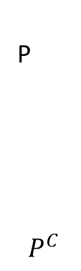

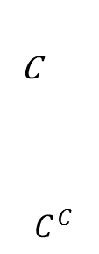
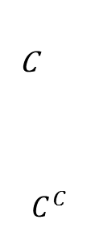
Probability Theory
Complete the tree diagram in Figure 5.1.
Let P = customer is personally able to travel.
Let $P^{C}$=customer cancels due to personal reasons.
Let C = customer arrives on time and is able to go on cruise
Let $C^{C}$=customer cancels due to not arriving on time due to the flight.
Prob personally able to travel
C
$$C^{C}$$
Prob personally able and on time
P
$$P^{C}$$
Prob personally able but not on time
C
$$C^{C}$$
Prob not personally able to travel
This one is tricker. If you can’t travel for personal reasons then it doesn’t matter if you are on time or not.
0.00
However, we are going to completely fill in the table.
Think about it this way -> If you can’t travel for personal reasons then you aren’t on time.
1.00

Slide 8
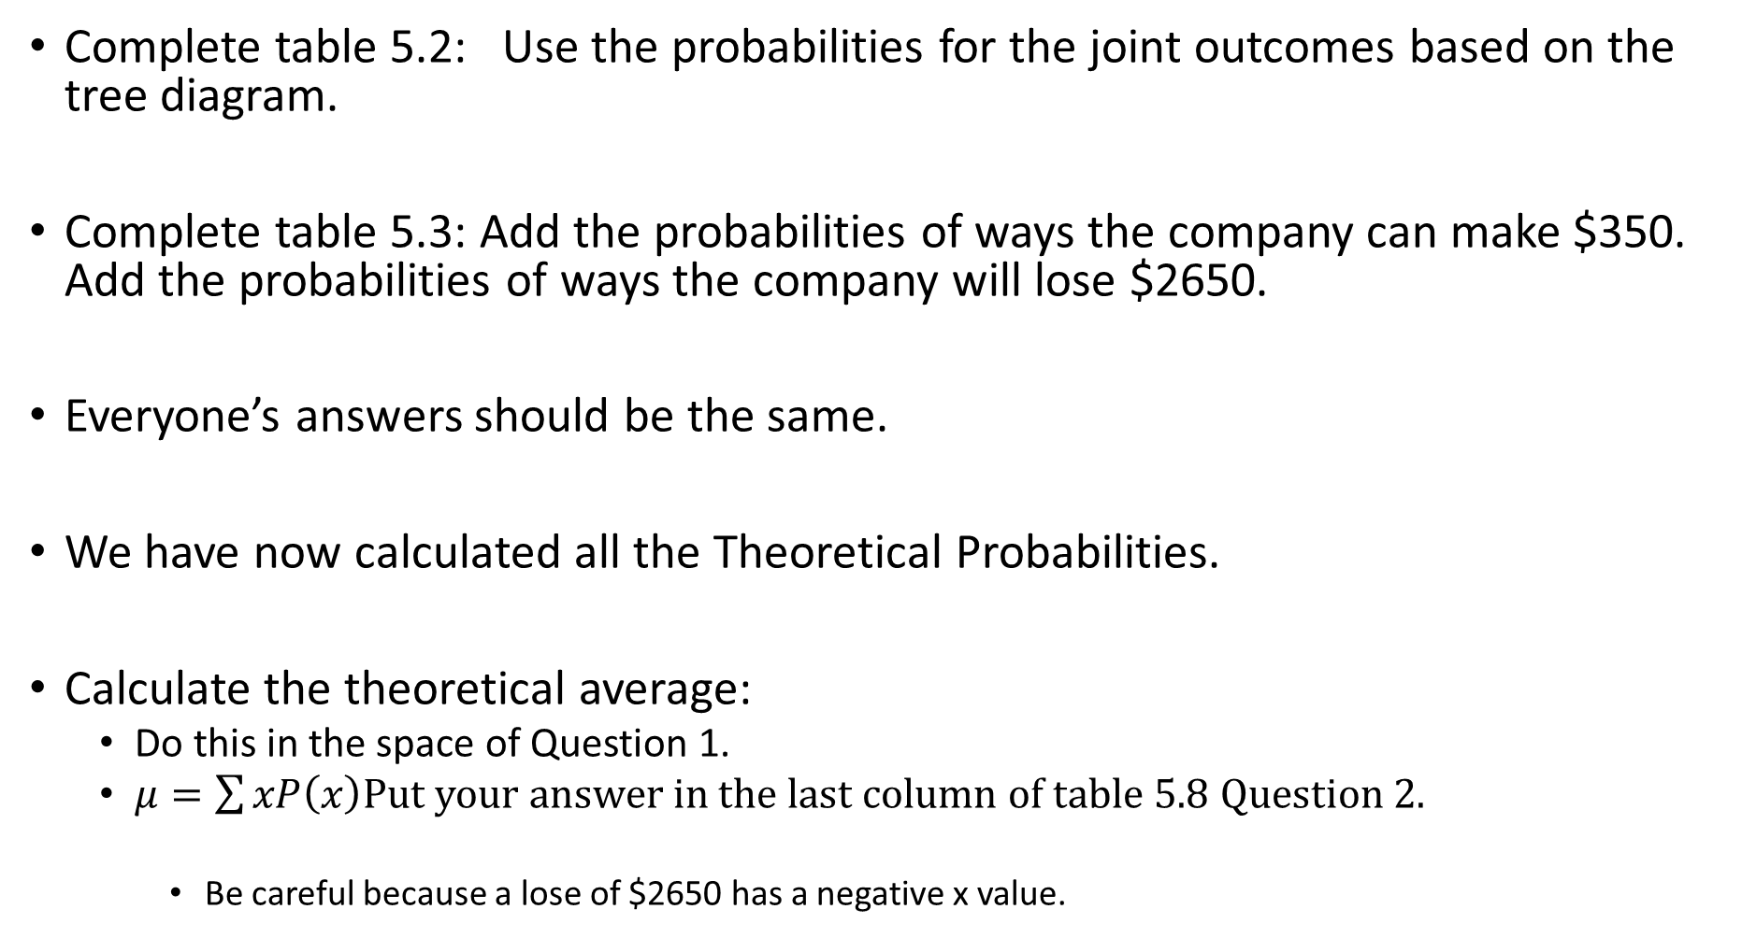
Complete table 5.2: Use the probabilities for the joint outcomes based on the tree diagram.
Complete table 5.3: Add the probabilities of ways the company can make $350. Add the probabilities of ways the company will lose $2650.
Everyone’s answers should be the same.
We have now calculated all the Theoretical Probabilities.
Calculate the theoretical average:
Do this in the space of Question 1.
$μ=\sum{xP\left(x\right)}$Put your answer in the last column of table 5.8 Question 2.
Be careful because a lose of $2650 has a negative x value.

Slide 9
Simulations of the Cruise Scenario
Working in groups of 2.
There are two buckets on your table:
Bucket 1: Travel
19 Can Travel Beads and 1 Can’t Travel Beads.
Gently shake the bucket to mix the beads and without looking draw one bead at random.
If can travel bead then draw from the flight bucket.
If can’t travel bead then you can’t travel for personal reasons.
Bucket 2: Flight
24 On Time Beads.
1 Cancelled/Delayed Bead.
IF YOU ARE ABLE TO TRAVEL FOR PERSONAL REASONS then gently shake the bucket and without looking draw a bead at random.
If on time bead then you are able to make the cruise.
If cancelled/delayed bead then you are not able to make the cruise.
One person draws and their partner records the results for them.
Each person will draw 25 times and record results in Table 5.4:
Note value in the column Insurance Company profit will be either:
$350 – if you make the cruise.
-$2650 if you can’t make the cruise. (regardless of reason).
After both lab partners have data each needs to calculate the data in table 5.5.
The mean calculated will go in the first column of table 5.8 Question 2.

Slide 10
Combined Trails for all Students
One at a time each person will tell me total number passengers that made the trip.
The values will be on the screen and calculated in Excel.
After all data is combined fill in table 5.7.
The mean calculated will go in the middle column in table 5.8 Question 2.

Slide 11
In the Results:
Everything on pages 37-39 should be filled in.
Discussion Questions:
Questions 1 and 2 should be complete.
Question 5 – read the reality check on page 35.

